Slide 1







IPHONE
Code Crushers Team
CUSTOMER REVIEWS
Data Analysis
Supervised by: Dr. Sara El-Mowafy
Prepared by: Code Crushers Team
Farah Hewedy, Ayat Mahmoud, Zeinab Mohsen, Mennna Harmas Date : 11/2024

Slide 2




I n t r o d u c t i o n
This presentation analyzes customer reviews for various products, focusing on factors such as ratings, review titles, descriptions, and verification status. The data collected spans multiple countries and covers a wide range of product variants. By understanding customer feedback, the goal is to provide actionable insights that can help improve product quality, customer satisfaction, and ultimately drive sales growth.
Ke y Que st i ons
How do customer ratings vary across different countries? Which countries have the highest and lowest product ratings?
Are verified reviews generally more positive than unverified reviews?
What are the most common themes or topics in the review titles and descriptions? Use text analysis to identify the most repeated words or common phrases.
Which product variants receive the best reviews?
Are certain variants consistently rated higher than others? How do review trends change over time?
Do product ratings improve or decline as more reviews are collected?

Slide 3

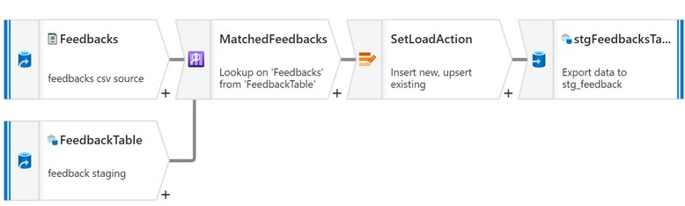
E L T P r o c e s s
D a t a
p i p e l i n e & d a t a w a r e h o u s e
D a t a
p i p e l i n e
We loaded our feedback data into azure data lake storage to be our source data that will load into our data warehouse.
We created a scheduled data pipeline to extract the data from the data lake storage and load it into a staging table so the data can be transformed later on based on our data warehouse model.
The data pipeline is configured to load the data if it’s new and update it if the data already exists.

Slide 4
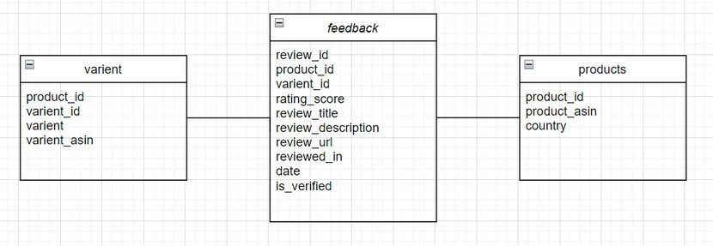

D a t a
w a r e h o u s e
m o d e l
We created our data warehouse model so the feedback table is our fact table and products and variant tables are both dimension tables.

Slide 5
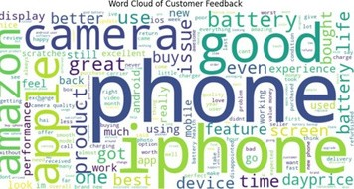
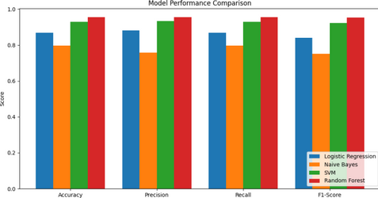
S e n t i m e n t A n a l y s i s
We analyzed X customer reviews and classified them into positive, neutral, and negative sentiments using various machine learning models such as : Logistic Regression, Naive Bayes, Support Vector Machine (SVM), and Random Forest.
The text data was preprocessed and vectorized using TF- IDF.

Slide 6
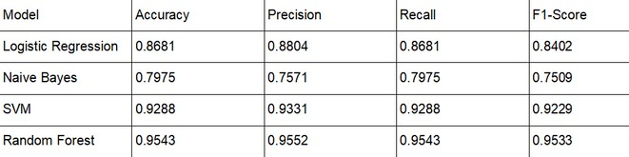

Model Performance Metrics
Track and manage sentiment analysis models using MLflow

Slide 7
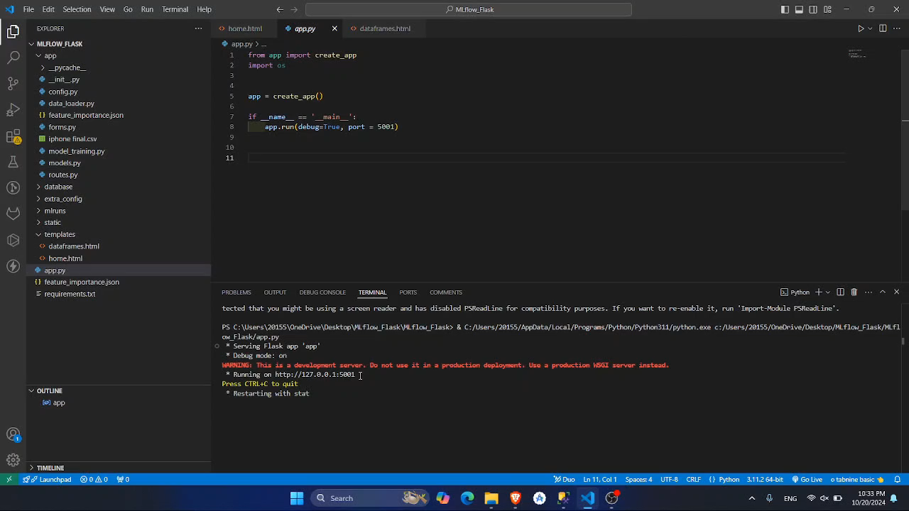
D e p l o y m e n t
Deploy a sentiment analysis model using a Flask web application to collect product reviews. The reviews are stored both in a database and a dataframe for efficient storage and further analysis

Slide 8

Data Analysis

Slide 9

I n s i g h t s
Encourage customers to make verified purchases by offering incentives such as discounts, loyalty points, or exclusive deals. Verified purchases could also be highlighted more prominently in the product listings to build trust and increase sales.
Tailor marketing strategies and product offerings to different regions. For Europe, investigate the lower ratings by collecting more specific feedback and addressing any regional concerns, such as delivery times or product expectations.
Highlight the features that customers consistently praise (e.g., "Great," "Excellent," and "Amazing") in marketing materials. At the same time, address the issues frequently mentioned in negative reviews (e.g., "Poor" or "Disappointing") by improving product quality or providing clearer expectations.
Focus marketing efforts on the most popular variants (e.g., color or size) and consider expanding inventory of those variants. Additionally, use the high- performing variants as benchmarks to improve the lower-rated ones.
Maintain or improve customer service and product quality to sustain the positive trend in review scores. Regularly update customers on product improvements and engage with those who leave feedback to show that their input is valued.

Slide 10



Code Crushers Team
Farah Hewedy
SQL Database Setup and Data Collection Database Design: Database Design: Set up an SQL database for customer feedback, including tables for feedback forms and profiles.
Data Collection: Import customer feedback data into the database.
SQL Queries: Write queries for data extraction and summary.
Tools: Microsoft SQL Server, SQL Management Studio.
Deliverables:
Database schema and populated tables. SQL queries for analysis.
Zeinab Mohhsen
Data Warehouse and Python Data Processing: Data Warehouse: Implement a warehouse to store aggregated feedback.
Data Integration: Load feedback data into the warehouse. Python Processing: Python is used to preprocess data, including text processing for sentiment analysis.
Tools: SQL Data Warehouse,
Deliverables:
Data warehouse with integrated feedback data.
Python scripts for data cleaning and pre-processing.
Menna Allah Harmas
Sentiment Analysis and Python Preprocessing: Sentiment Analysis: Build Python models to classify feedback sentiment.
Model Evaluation: Test and refine sentiment models. Tools: Python (Scikit-learn, SpaCy), Azure Data Studio. Deliverables:
Sentiment analysis report with model metrics. Python Preprocessing:
Ayat Mohamed
MLOps and Final Presentation:
MLOps: Use MLflow for tracking and managing models. Deployment: Deploy the model via a web app/dashboard for feedback insights.
Final Report and Presentation: Summarize all project stages.
Tools: MLflow, Azure services, web frameworks (e.g., Flask, Streamlit).
Deliverables:
Deployed model or web app.
Final project report and presentation.

